Slide 1
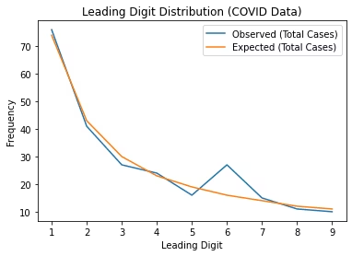
Benford's Law in Stars Dataset
Presented by Team: Neural Theorems
Akash Dhar Dubey
Yash Kishor Mali
Himanshu Gulhane
Ayush Kumar

Slide 2

Table of Contents
Introduction & Dataset
Overview of Benford's Law and dataset details.
Data Cleaning & Analysis
Preparation and Benford frequency examination.
Statistical Tests
Chi-Square goodness-of-fit results.
Visual Insights & Conclusion
H-R diagram and key takeaways.

Slide 3
What is Benford's Law?
Benford's Law explains the frequency distribution of leading digits.
Applications
Fraud detection in finance and accounting
Digit 1 appears about 30% of the time, decreasing as digits increase.
Scientific data validation
Election and census anomaly detection
Formula: p(d) = log10(1 + 1/d)

Slide 4

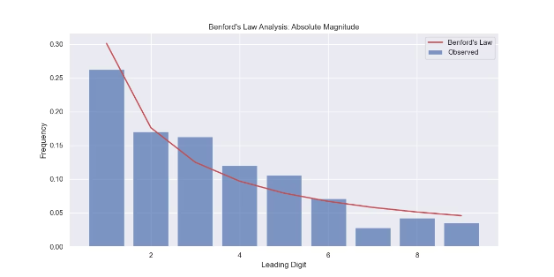
Dataset Description
Source
Key Columns
Data Scope
Stars Dataset CSV, extracted from Google Sheets.
Visual Magnitude, Absolute Magnitude, Parallax, Distance (light years).
Contains detailed star properties for analysis.

Slide 5


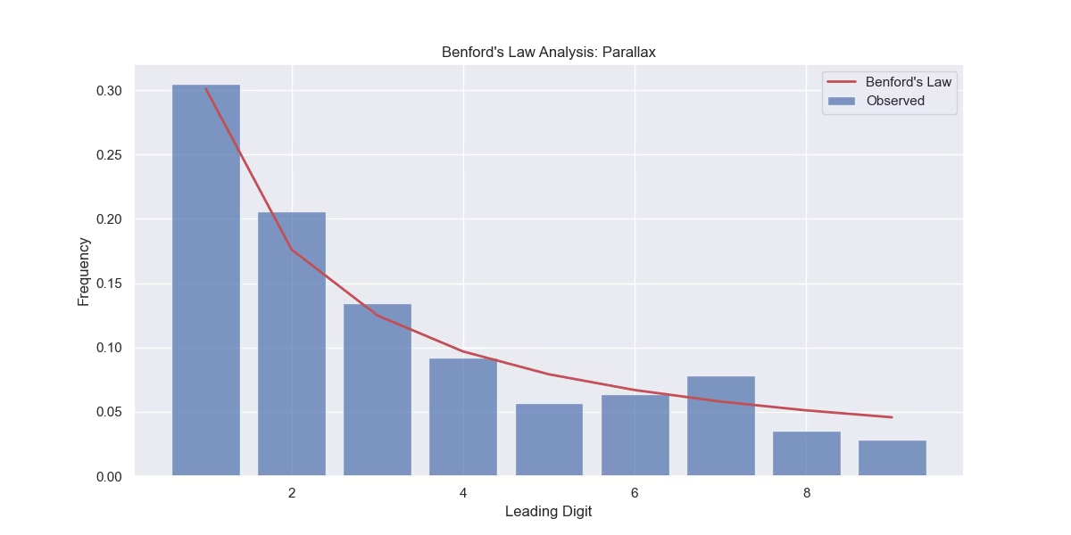



Data Cleaning & Preparation
Clean Column Names
Removed extra spaces for consistency.
Numeric Conversion
Converted key columns to numeric types.
Error Handling
Coerced errors during conversion to manage invalid data.
Missing Data Removal
Dropped rows missing critical values for analysis.

Slide 6
Benford's Law Analysis
Digit Extraction
Comparison
Leading digits extracted from numeric star data.
Expected Benford frequencies contrasted with observed.
Observed frequencies calculated per digit.
Visualized differences using combined bar and line charts.

Slide 7

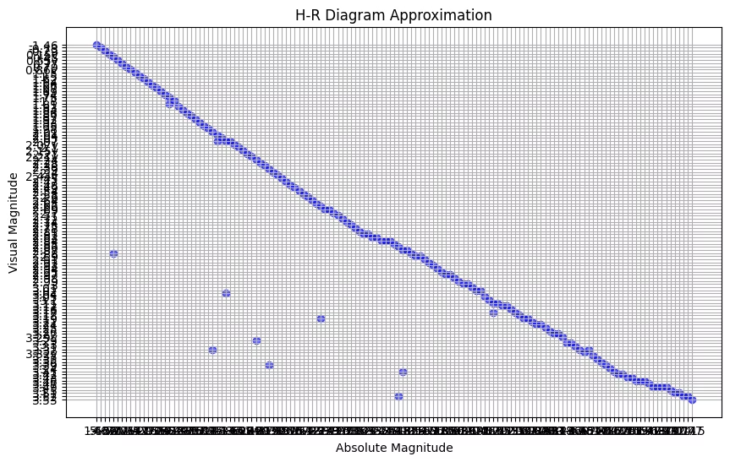
Chi-Square Test
Goodness-of-Fit Test
Test Results
Chi-square value low, p-value high.
Chi-square test compared observed with expected frequencies.
Conclusion
Data conforms closely to Benford's Law distribution.

Slide 8
H-R Diagram Approximation
Axes Plotted
1
Visual Magnitude vs Absolute Magnitude.
Y-Axis Inverted
2
Matches convention of HR diagrams.
Stellar Insights
3
Diagram reveals star types and luminosity classes.

Slide 9

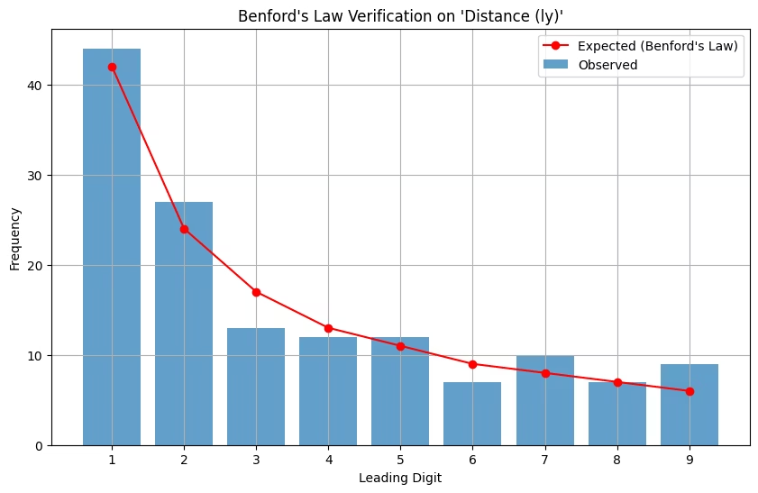
Individual Contributions
Name
Contribution
Akash Dhar Dubey
Data Cleaning, Digit Extraction, Benford Analysis
Yash Kishor Mali
Chi-Square Test Implementation
Himanshu Gulhane
H-R Diagram Creation, Expected Frequency Computation
Ayush Kumar
Data Processing, Final Frequency Comparison

Slide 10

Thank You 🙏
We appreciate your attention and welcome any questions or feedback.

